Slide 1

Eastvantage Sales Dashboard

Slide 2
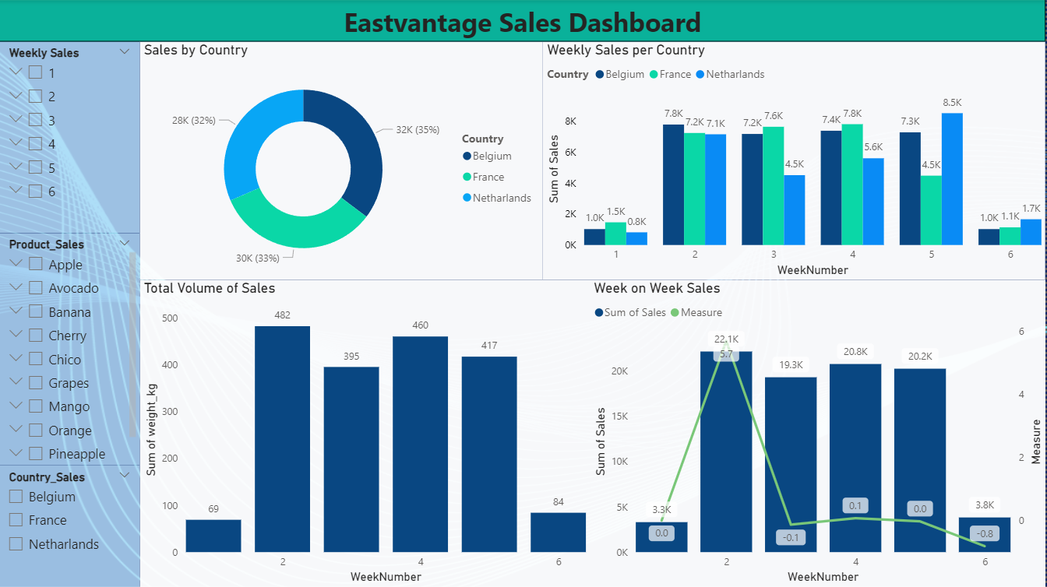

Slide 3
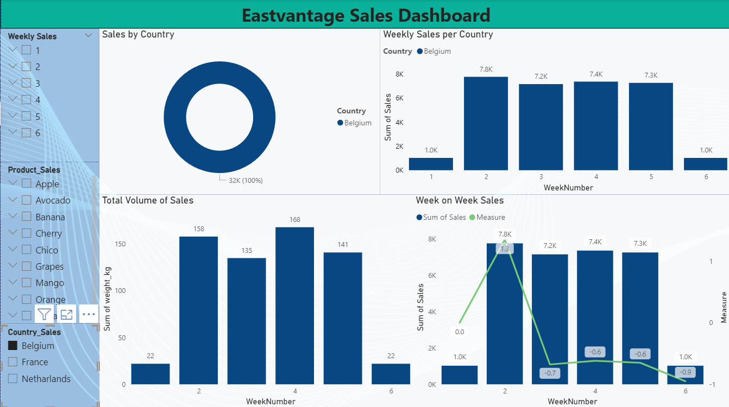

Slide 4
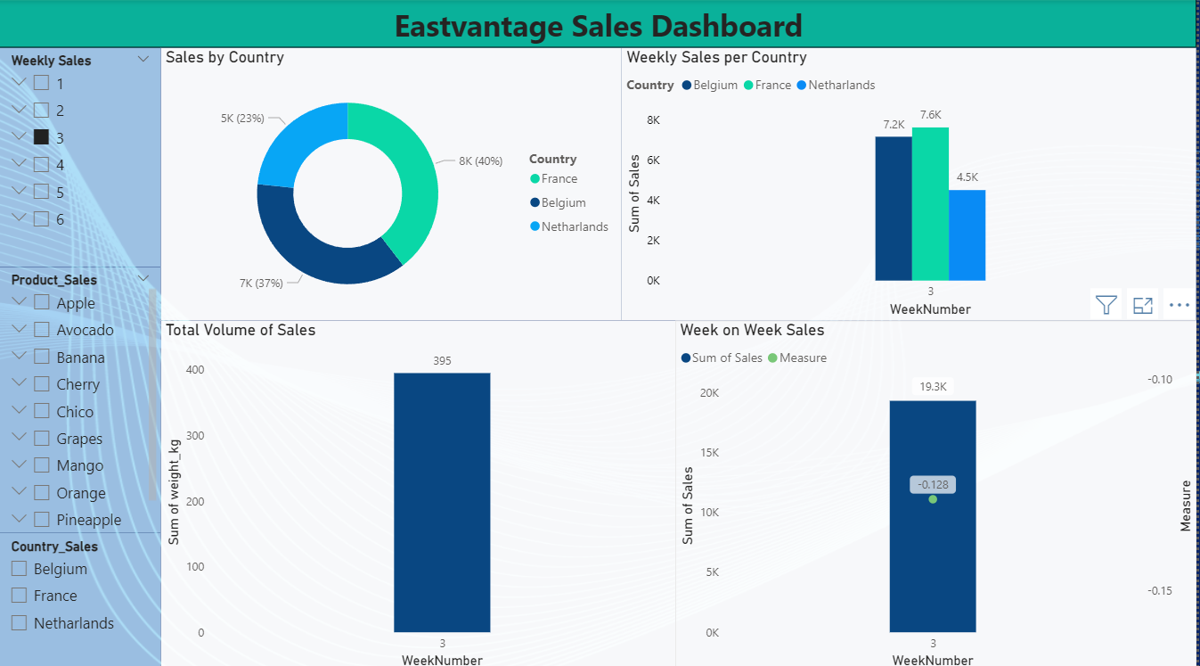

Slide 5
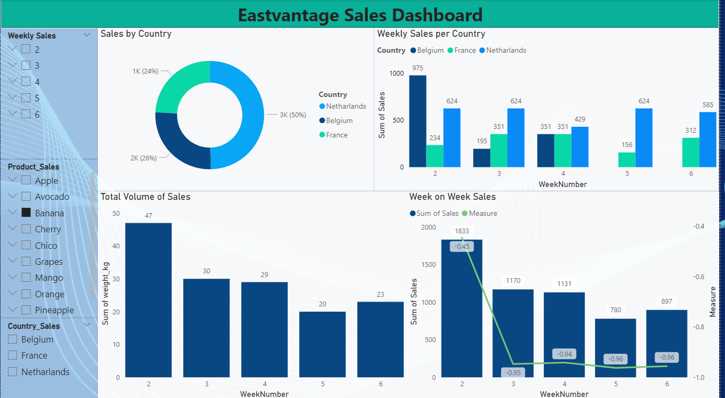

Slide 6
Power BI Code
Measure =
VAR lastWeekAmount =
CALCULATE (
SUM ( Sheet1[sales] ),
FILTER (
ALL ( 'Sheet1' ),
'Sheet1'[WeekNumber]
= MIN ( 'Sheet1'[WeekNumber] ) - 1
)
)
RETURN
DIVIDE ( SUM ( Sheet1[Sales] ) - lastWeekAmount, lastWeekAmount, 0 )

